Slide 1
Game GUI
UnityGUI

Slide 2
The Scoreboard
The scoreboard only needs to display, with no interaction required.
Create a new script: FuguBowlScoreboard
Create a new GameObject in the Hierarchy View, name it Scoreboard, and attach the FuguBowlScoreboard script to it.

Slide 3
The Scoreboard
UnityGUI controls are created inside OnGUI callback functions, which are called every frame
Put the following in the script file:
function OnGUI() {
GUI.Label(Rect(5,100,200,20),"This is a label");
}
GUI.Label draws a label, passing in a Rect (rectangle) that specifies the label is to be drawn at x,y coordinates 5,100 and with a width and height of 200 and 20 pixels, respectively.
The second argument is the text to display in the label. Click Play and you should see “This is a label” appear on the screen.

Slide 4
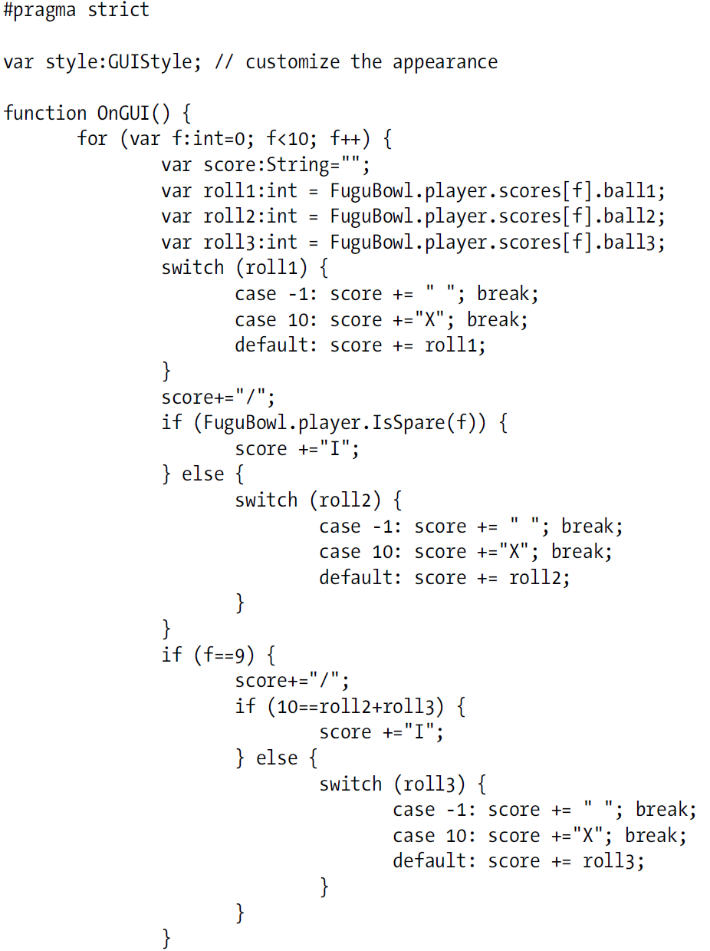
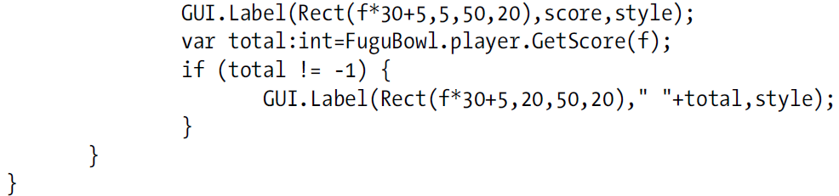
The Scoreboard
A better score:

Slide 5
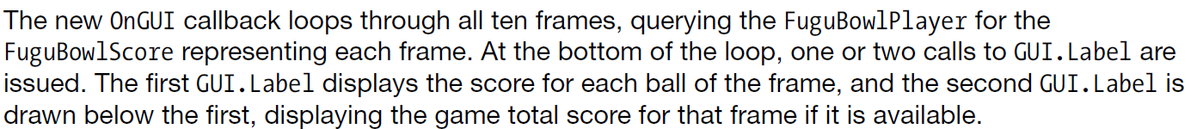
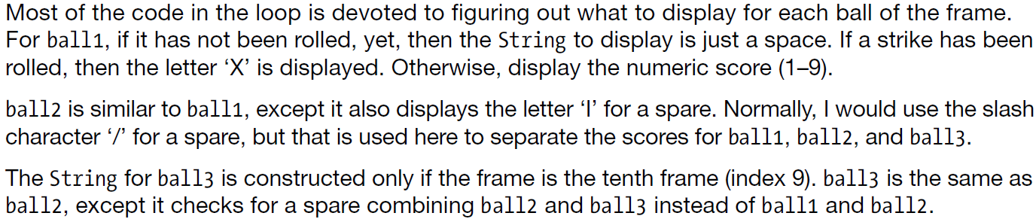
The Scoreboard

Slide 6
Style
GUIStyle is a collection of properties that affect the display of the Control - similar to how Cascading Style Sheets (CSS) are used in formatting web content.
The GUIStyle passed to the GUI.Label is bound to a public variable named style, which allows customization of the GUIStyle in the Inspector View.

Slide 7
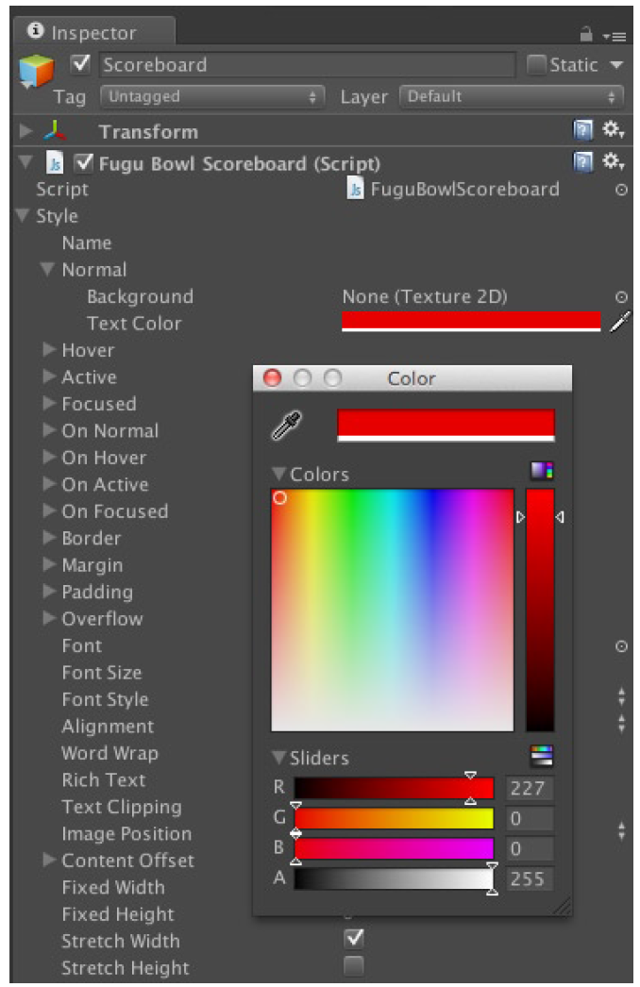
Style
Any font in TrueType, OpenType, or dfont format can be imported into Unity.
Other GUIStyle properties control the font size and style (for Font assets imported as dynamic fonts), text alignment, and word wrap.

Slide 8
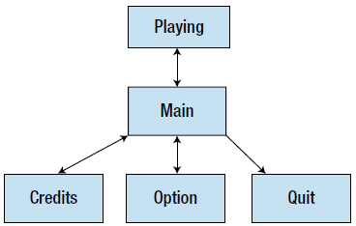
Pause Menu
a main menu and two submenus: one for game options and one to display the game credits. The options menu will have distinct panels for audio, graphics, system, and stats.
thinking of each top-level menu screen as a state.
All states except for Quit (which you can think of as the exit state) can transition back to the state that transitioned to them in the first place, which is why each transition arrow is drawn bidirectional.

Slide 9
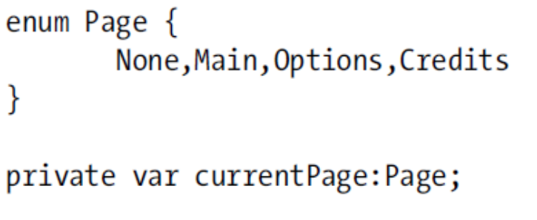
Pause Menu
Create a new script:FuguPause and a new object: PauseMenu
We can call these different view as ‘pages’
We need to differentiate between them:

Slide 10
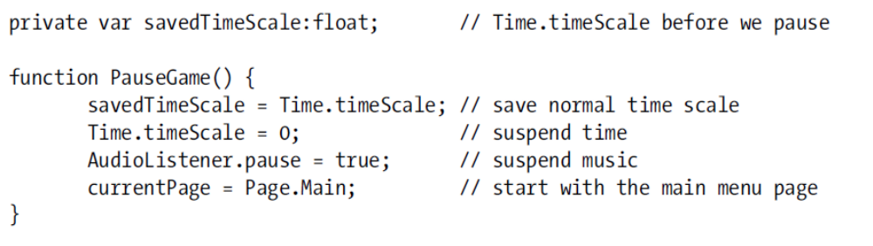
Pausing the Game
The static variable Time.timeScale specifies how fast the simulated game time progresses and defaults to 1. Setting Time.timeScale to 0 effectively pauses the game, suspending physics, animation and anything else dependent on the advance of Time.time.

Slide 11
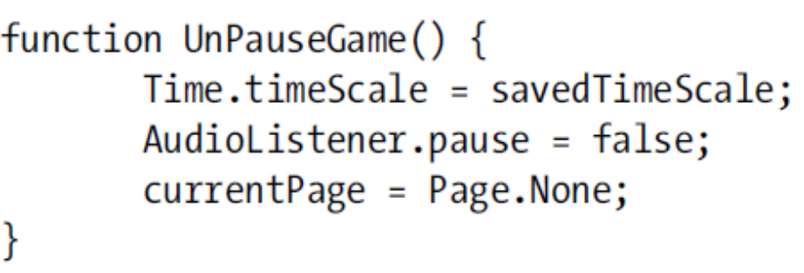
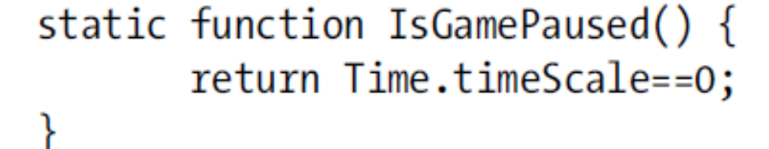
To un-pause:
Check if paused?

Slide 12
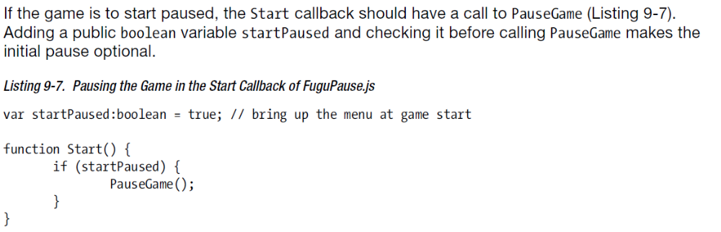
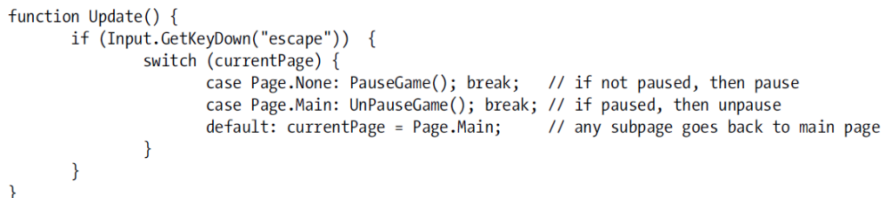
So we start paused.
How do we begin: perhaps use the ESC key?

Slide 13
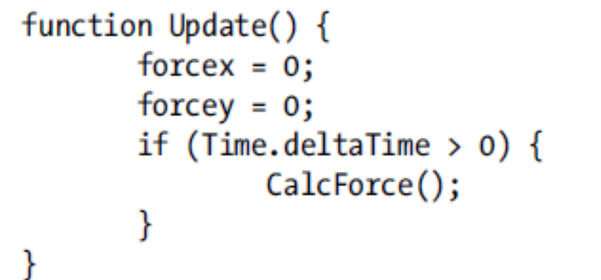
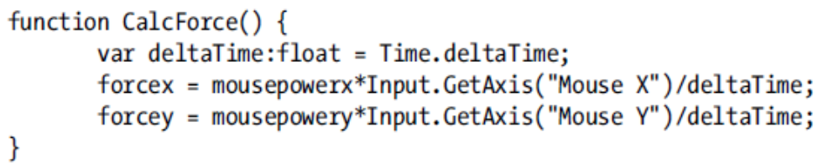
Time.deltaTime
If we are paused, then Time.deltaTime is zero, which causes divide by zero error:
to ensure that no lingering force is applied to the bowling ball while the game is paused.

Slide 14
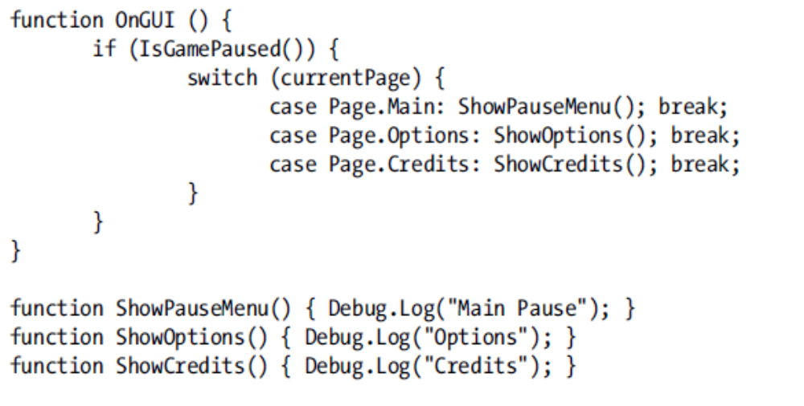
The Menu
there are placeholders for each of the page display functions for now

Slide 15
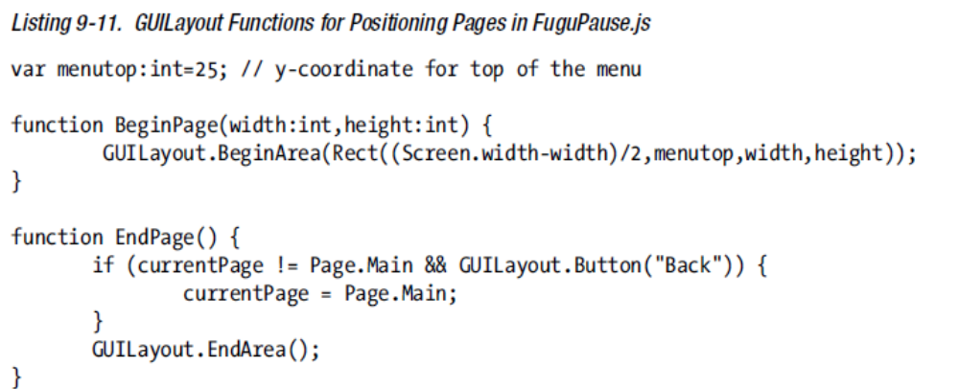
GUILayout & GUI.Button
Between calls to GUILayout.BeginArea and GUILayout.EndArea you can make calls to create GUI Controls without passing a Rect to each one, using the GUILayout versions of the GUI functions. The Controls will be automatically placed and sized within the Rect that was passed to GUILayout.BeginArea.

Slide 16
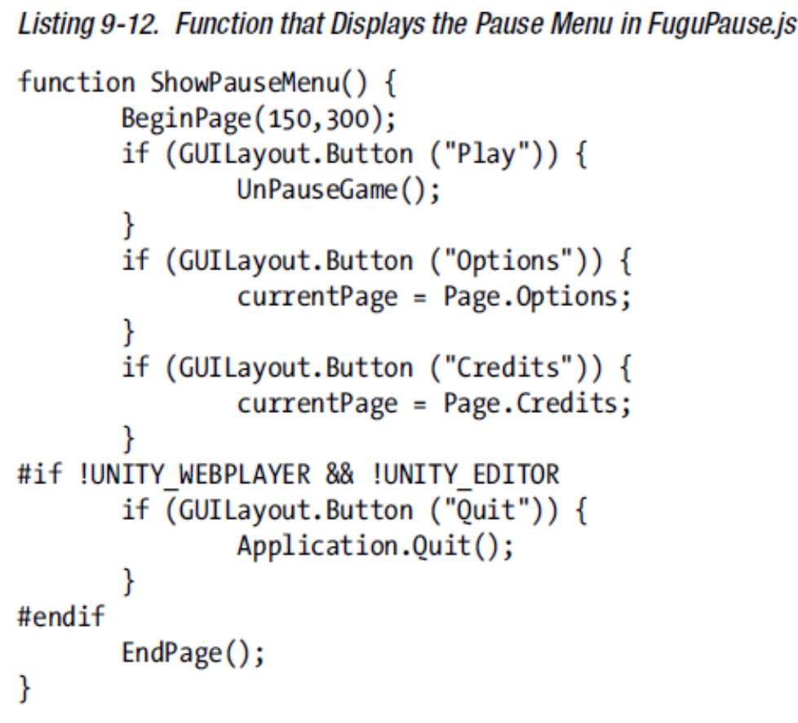

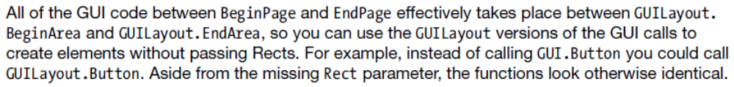
The Main Page

Slide 17
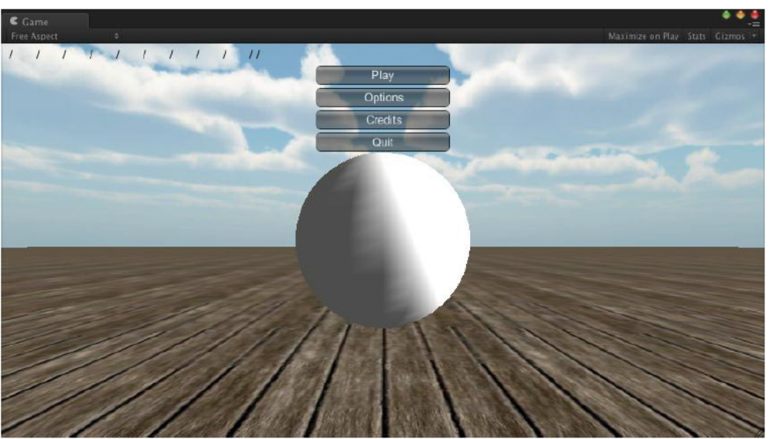

Slide 18
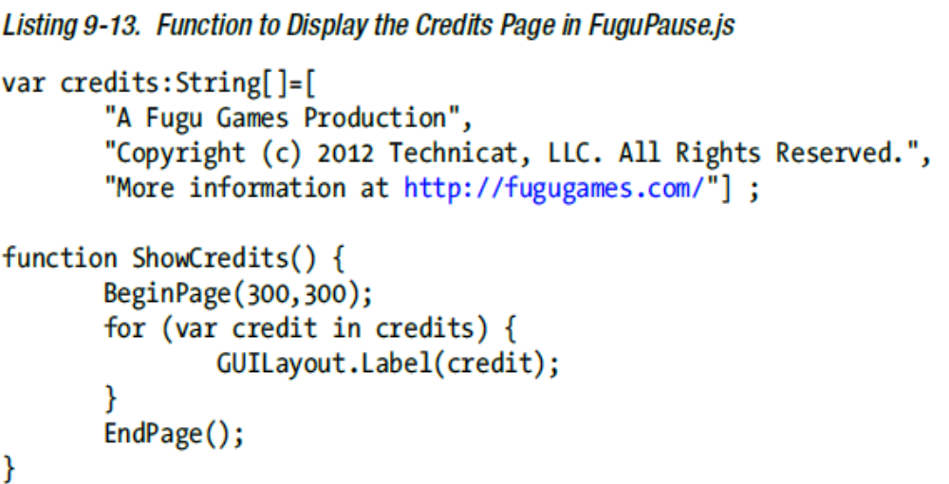
Credit Page
We can modify this in the editor view

Slide 19
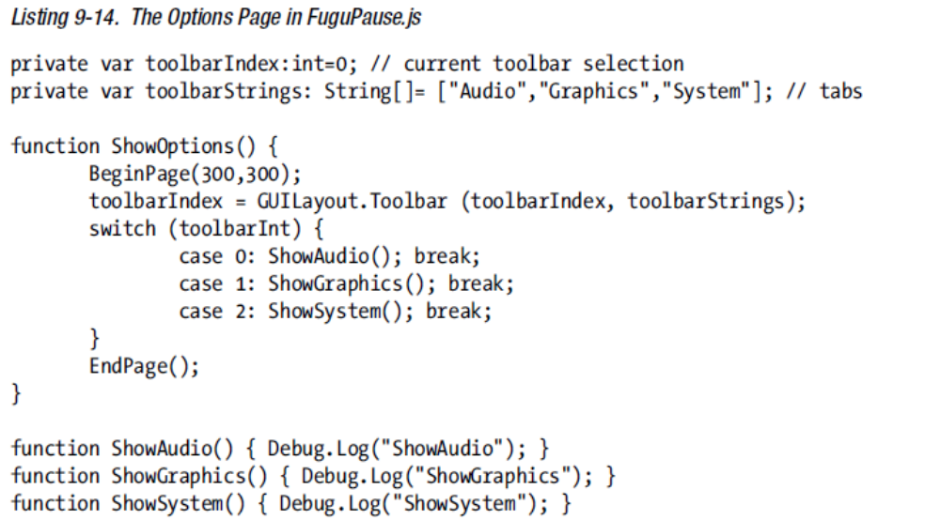
Options Page
GUILayout.Toolbar creates a toolbar—a row of buttons that acts as a tab or radio button—from a String array, where each String is the label of the button.

Slide 20
But GUILayoutToolbar returns an integer that represents the currently active button, so you feed that value back into the variable that you passed in, toolbarIndex:

Slide 21
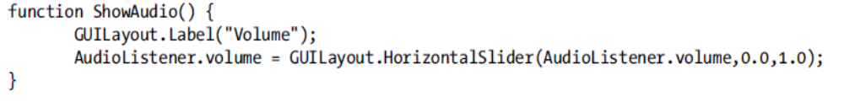
The Audio Panel
We want to display a slider for volume control

Slide 22
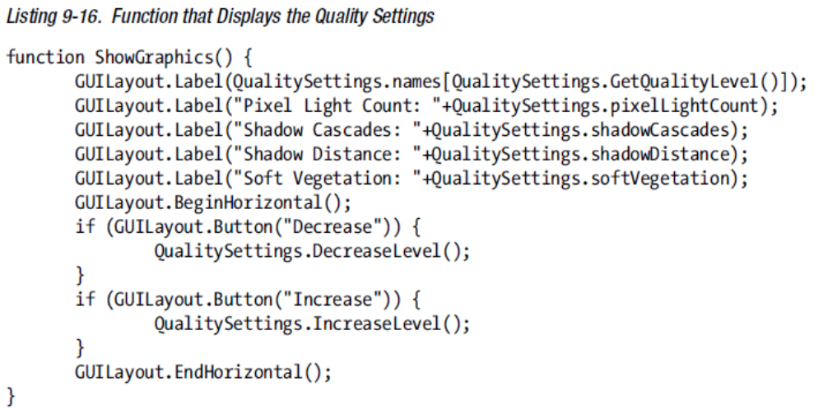
The Graphics Panel
display some of the same graphics quality information shown by the Quality Settings of the Unity Editor

Slide 23
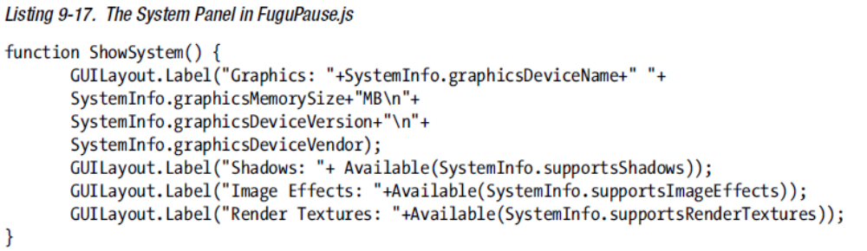
The System Panel

Slide 24
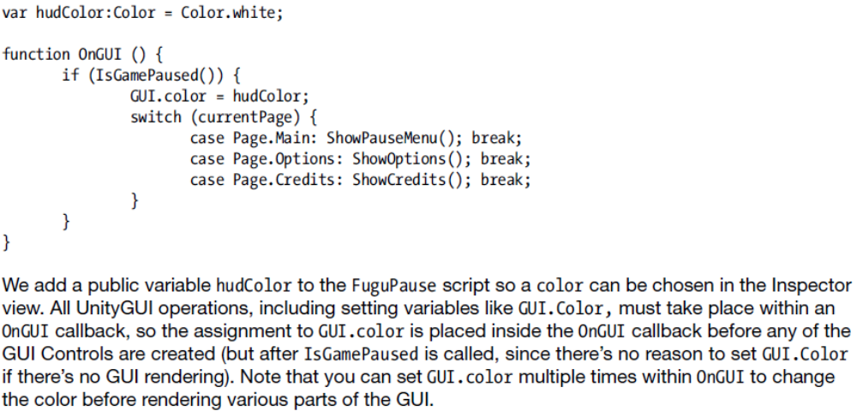
Customize the GUI Color
Use the inspector to choose a color

Slide 25
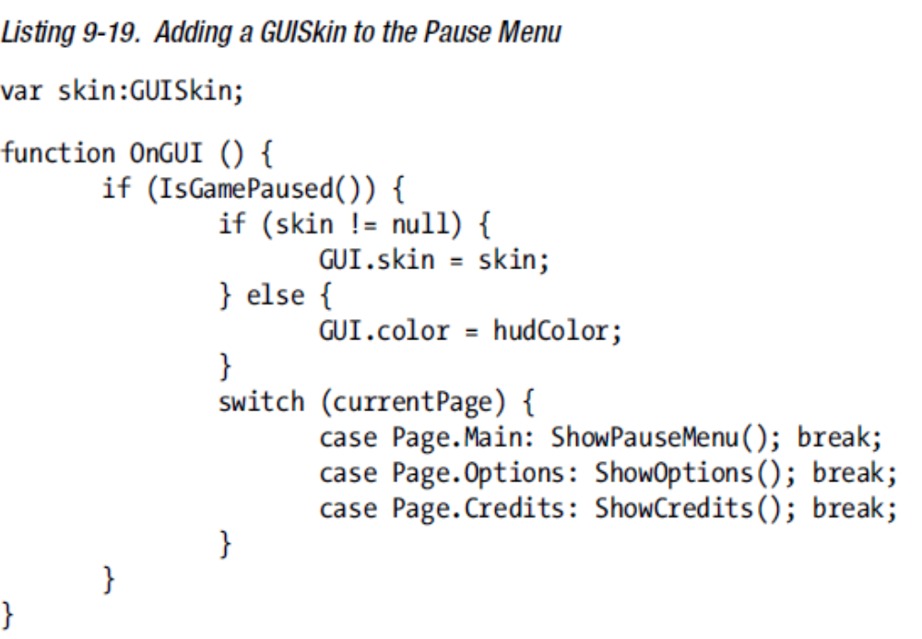
get a Skin

Slide 26
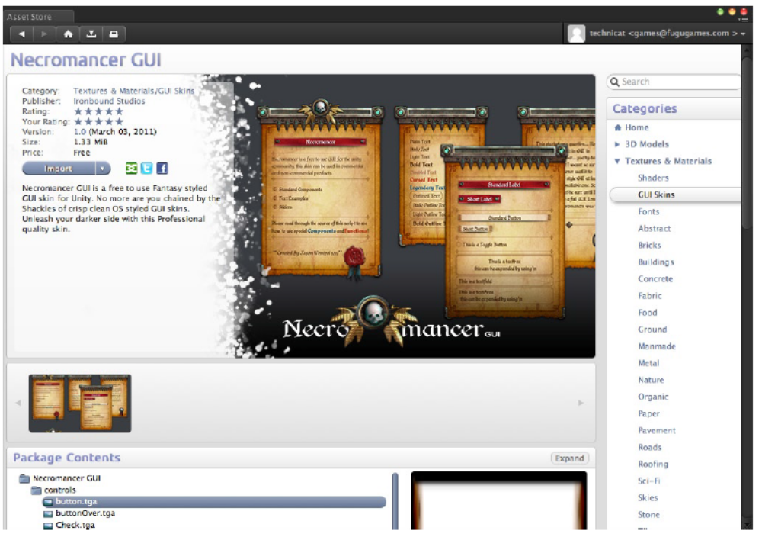

Slide 27
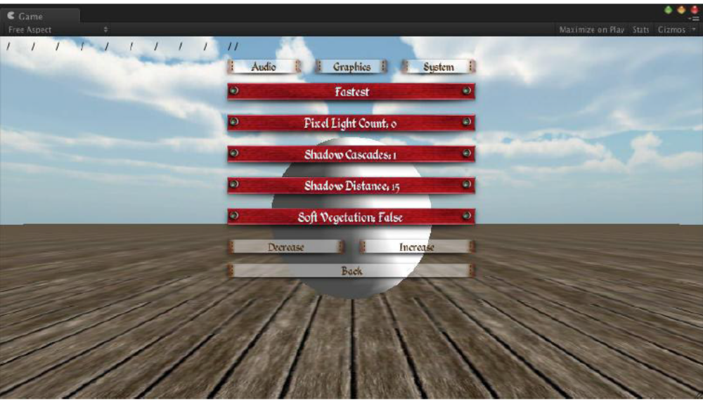

Slide 28
Explore
Scripting Guide:
https://docs.unity3d.com/Documentation/Components/GUIScriptingGuide.html

Slide 29
Other Chapters:
Using Unity iOS
Building for Real: Device Testing and App Submission
Presentation: Screens and Icons
Handling Device Input
  Touch
  Accelerometer
  Camera
Game Center
iAd: Banner Ads and Interstitial Ads
Optimization

